Slide 1
Triple Aim Outcome Measures
Name
Institution
Health Care Models Used in Care Coordination
Triple Aim Outcome Measures
Date

Slide 2
Objective
Define Triple Aim
Analyze Health care models and explain how triple aim fits into the plan of care.
Explain how evidence-based data shapes the care coordination process
Describe governmental regulatory initiatives that assist in achieving triple aim
Identify process improvement recommendation
Notes:
The

Slide 3

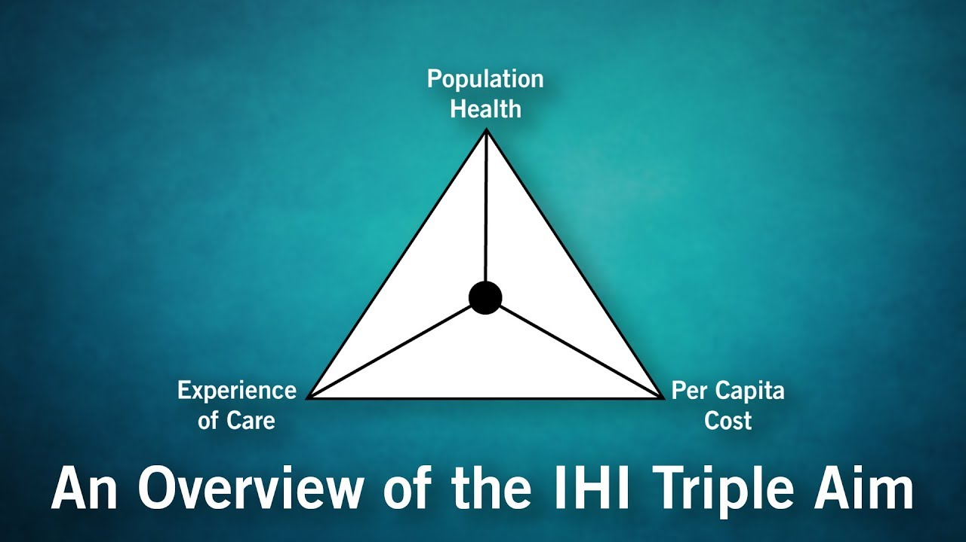
Triple Aim
Goal
  Improve patient experiences and outcomes
  Improve the health of population
  Reduce the cost of care
                Figure 1. Institute for Healthcare Improvement, n.d.)
Notes:
The Triple Aim framework was created in 2007 in a 90 day research and development projected by the Institute of Healthcare Improvement [IHI] ( Lewis, 2014). It now serves as the foundation for hospitals and communities to provide care while improving the health of the individuals and the community. The purpose of Triple Aim is to boost the patient experiences and outcomes when receiving care, improve the health of populations, and reduce the overall cost of care (IHI, n.d.)

Slide 4

Experience of Care/Patient Satisfaction
Health care systems needs to assess :
  Overall health of community
  Identify current concerns or risks
  Overall mortality
Initiatives aimed at improving a patients ability to use the systems easier:
  Improve communication among providers and facilities
    Electronic health records (HER)
    Accountable Care Organizations (ACOs)
    Managed Care Organizations (MCOs)
    Shared Decision Making
    Patient-centered care teams
                (Norman, 2019)
Notes:
Improving the patient experience and satisfaction is one of the three components of Triple Aim. As shown on this slide, patient experience and satisfaction have several things that must be assessed by the facility. But are we actually asking ourselves what matters to the patient? Balik, White, and Macfie (as cited in Eng, 2018) explain that we, as healthcare workers, often times assume what the patient experience is. but never actually takes the time to ask our patients of their concerns, or pick up on physical and emotional cues during visits. Macfie (as cited in Eng, 2018) went on to say that data shows patients are more interested in healthcare professionals listening to them than short wait times. We as healthcare professional need to be mindful that what we perceive as improved patient experience and satisfaction, might not be how the patient feels. Therefore we need to ask our patients and families how can we improve their healthcare experiences? We can collect information through use of patient satisfaction surveys, and develop quality improvement initiatives to assist in our advancement.

Slide 5

Decreasing Per Capita Cost
Affordable healthcare to all
Quality care at reasonable cost
Cost reduction is difficult when trying to increase quality
  Identify at risk populations
  Address community health issues
Notes:
The U.S. has the most expensive health care in world, however the U.S. is motivated to improve the quality of care while decreasing the cost. Norman (2019) identifies why this is challenging for the U.S. 1) aging population with chronic health complications 2) chronic health condition are expensive to diagnosis, treat, and care for.

Slide 6

Improving Population or Community Health
Identify risk of community
Understand that anyone could be a potential patient
Develop strategies that offset cost and provide coordinated patient-centered care.
IHI’s 5 recommendation
  Involve patients/families in care model design
  Restructure primary care services
  Improve disease prevention and health promotion
  Create cost-control platform
  Support integration of services (Norman, 2019)
Notes:
Another one of the three components to Triple Aim is improving population/community health. The first step in this process is to identify the community and any health risk factors that are involved. It is important to understand that anyone in the community is a potential patient even if they don’t seek care currently. Next, you must develop strategies that offer coordinated patient-centered care at a reasonable cost. The IHI offers 5 recommendations to health care facilities that are looking to improve the care they provide to the current community. They are a follows :
1. Involve patients/families in care model design
2. Restructure primary care services
3. Improve disease prevention and health promotion
4. Create cost-control platform
5. Support integration of services (Norman, 2019).

Slide 7
Health Care Models
Employee-Centered Care Model
Core Health Program
Care and Payment Model
Notes:
Here are a few health care models that are working towards achieving the Triple Aim goal 1) Employee-centered care model, 2) Core Health Program, and 3) Care and Payment Model.

Slide 8
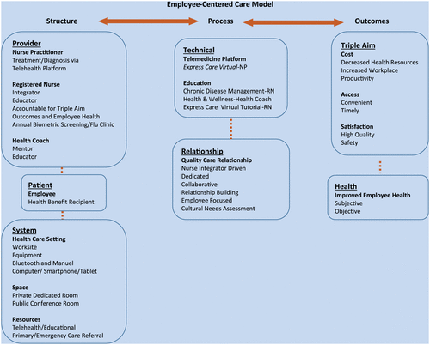
Employee-Centered Care Model
Employee-Centered Care
  Focus is on corporate environments
  Hybrid approach utilizing on-site care with virtual health
  Works on minor health issues
Supports goal of Triple Aim through
    Structure
    Process
    Outcomes
      Figure 2. Employee-centered Care Model
Notes:
Employee-Centered Care Models involves cutting overhead cost, provider utilization, and employee-centered personal care (Fox & McCorkle, 2018). Care is received through virtual telehealth clinics. These clinics can provide immediate care via a telehealth platform where a physician, NP, RN, or health coach are able to triage, diagnosis, and treat simple health issues. Further laboratory and x-rays can be order if needed and prescriptions can be sent to local pharmacy for patients. This virtual platform can also assist in preventive health and wellness education, chronic disease management, and biometric screening, such as monitoring blood pressures, weights, blood sugars (just to name a few) all from the patients place of employment. This concept decreases missed work hours, increases employee satisfaction, improves access to care, and cuts overall cost. According to McCaskill, Schwartz, Derouin, and Pegram (2014) this models could save $66,193.23 to $79,503.91 in medical cost per cost. This model supports Triple Aim through structure, process, and outcome. In the structure phase the provider, patient, and health care setting, work through the process phase by means of telehealth platform to build relationships that lead to positive outcomes, decrease cost, improved patient health and satisfaction, in a timely and convenient method that best suits the patient (employee) to increase over health and wellbeing of the patient.

Slide 9
Core Health Program
Spectrum Health in Michigan partnered with Health Communities Department
Program began in 2009
Efforts are to :
  Provide access to unserved people with limited access to health care due to
    Demographics
    Economic status
    Cultural and language barriers
Supports the goal of Triple Aim by:
  Increase patient participation in their health
  Reduce inappropriate and unnecessary ER visits
  Reduce hospital readmissions
  Reduce overall cost of care
Notes:
The Core Health Program began in 2009 when Spectrum Health in Michigan partnered with health community department to assist in providing care to individual and families who lived in rural areas and were unserved. The goal of the program was to provide education and support of patients living with CHF and diabetes in rural Michigan(Fawcett, Neff, Freese Decker, & Faber, 2018). This is a 12-month free program to qualifying patients. The goal of the program is to educate patients on self-management skills. Patient-centered home visit are completed to educate on medication dosage and the importance of compliance, exercise and fitness, diet, and disease specific self-management techniques. The programs works with the patients and their families to improve overall health, making lifestyle changes and setting personal health goal that meet their cultural needs. Since the start of this program, Healthcare Effectiveness Data and Information Set (HEDIS) a system used to quantify outcomes, has seen significant improvement in disease prevention, improved nutrition and physical activity, reduced obesity and tobacco use, and efficient use of health care services. Furthermore, a positive return on investment (ROI) and decrease in overall cost, especially related to emergency visits and inpatient hospital readmissions (Fawcett, Neff, Freese Decker, & Faber, 2018). .

Slide 10
Care and Payment Model
American Hospital Association (AHA) Committee on Research and Committee on Performance Improvement (2015) created:
  Care and Payment Model
    Allows hospitals to develop a delivery systems and payment methods that best meets the needs of the facility and the community
    Uses patient perspective way of thinking
    7 key principles
      Design care with the whole person at the center
      Empowers patients and delivery system with technology
      Develops care coordinations teams
      Integrates behavioral health and social contributing factors
      Collaborative leadership
      Integrates care into the community
      Creates safe and highly reliable care organizations
Notes:
Next is the care and payment model that was founded by the American Hospital Association (AHA) Committee on Research and Committee on Performance Improvement in 2015. It allows hospitals to develop delivery systems and payment method that best meets the needs of the facility and the community they serve (AHA, 2016). The care and payment model has 7 key principles 1) Design care the with the whole person as the main focus point. This involves putting each patients needs and access to care before the needs and convenience of the facility or health professional. 2) Empowers patients and delivery of care with technology and information. This is accomplished by allowing, and encouraging patients to participate in their own care, so the promotion of life-long health can be achieved. 3) Develop care coordination teams to assist in providing high-quality care through collaboration and teamwork. 4) Integrate behavioral health and social contributing factors to ones physical and emotional health through diagnosis, treatment and prevention methods. 5) Collaborative leadership that includes clinicians, and executive leadership to promote diversity. 6) Integrate care in the community by partnering with local organization, churches and other community services to obtain the best health outcomes for our patients. 7) Create a safe and highly reliable organization by offering a safe and welcoming culture that strives to improve safe, high-quality care to our patients. ( AHA, 2016, pg 6.) It is important to understand that creating a care and payment model will be challenging. Facilities must research and experiment with various models in order to develop the best model for their organization and community.

Slide 11
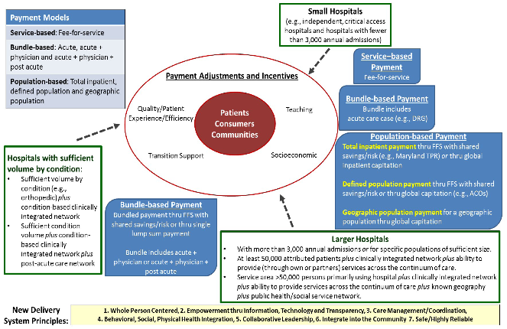
Figure 3. Value bases payment for Triple aim
Notes:
This picture explains the three initial payment approach concepts that were developed in 2015 by the AHA Committee on Research, and the Committee on Performance Improvement (2016). The first payment option is Services-based payment, which is fee for service. This means that services are paid separately, so the physicians can provide more treatments, and payment is on quantity of care rather than quality. The second payment option is Bundled-based payment, which means that care cost are predetermined and providers assume risk. This type of payment is intended to improve the quality of care and outcomes at a lower cost (NEJM Catalyst, 2018). The final payment option is Population-based payment, which is the combined care and cost to a population (AHA, 2016). Organization must evaluate their facility and community needs first in order to figure out if one of these payment options would work for them. It is important to recognize that new options have since been developed and may better suit the needs of the facility and community.

Slide 12
Evidence-based Data
Evidence-based data is important because it is the combination of clinical expertise, and evidence-based research (Steven, 2013).
  Goal of EBD – improve care process and patient outcomes
Care Coordination – organizing patient care and sharing all information with care team member to provide the most effective, safe care (Agency for Healthcare Research & Quality [AHRQ], 2018).
  Main goal is to meet the patients needs and preferences while providing high-quality care (AHRQ, 2018).
Notes:
Evidence-based data is important to healthcare and nursing because it is the combination of clinical expertise and evidence-based research (Stevens, 2013). Care coordination entails organizing patient care and sharing all information with care team member to provide the most effective safe care (Agency for Healthcare Research & Quality, 2018). It is important because it can improve efficiency, effectiveness, and safety of care, while improving outcomes for patients, providers, and payers. Care coordination involves teamwork through communication and knowledge sharing, care/case management including follow-up and monitoring of care, medication management, health information technology, patient-centered care supporting patients views and goals, assisting with community resources and more (AHRQ, 2018).

Slide 13
Governmental Regulatory Initiatives
Centers for Medicare and Medicaid Services (CMS)
  Value-based programs
  Meaningful measures
Notes:
There are several governmental regulatory programs that can be applied in the care coordination process to achieve the Triple Aim within a population.
Better Care: Improve the overall quality, by making health care more patient-centered, reliable, accessible, and safe.
Healthy People/Healthy Communities: Improve the health of the U.S. population by supporting proven interventions to address behavioral, social, and environmental determinants of health, in addition to delivering higher-quality care.
Affordable Care: Reduce the cost of quality health care for individuals, families, employers, and government.

Slide 14
National Quality Strategy
  Better Care: Improve the overall quality
  Healthy People/Healthy Communities: Improve the health of the U.S. population
  Affordable Care Act (ACA)
https://www.ahrq.gov/workingforquality/about/index.html

Slide 15
Process Improvement Recommendation
Improve staff turnover
Improve Care Coordination
Implement telehealth
Mental health programs
Initiate :
  Transitional Care Model
  Core health program
  Home-based primary care
Notes:
Being a new care coordinator at Sacred Heart Hospital (SHH) is a small rural hospital in Valley City, North Dakota . From my interviews with various staff and community member I have learned a lot about the current struggles this facility is experiencing. The overwhelming consensus is that patients and community members either struggle with maintain follow-up care or don’t receive care until absolutely necessary. SHH is currently dealing will high nursing turnover that could be related to a number or issues such as work environment, high workload, extended work hours, decreased wages, and patient commitment and participation in care (Capella University, n.d). Follow-up care and health maintenance are major concerns that need to addressed quickly. My recommendation is that care coordinators start to work with community resources such as local churches, health department, commission on aging, other organizations that could assist in serving the community member with follow-up care. Programs like Transitional Care Model, Core health programs, and Home-based Primary Care can be initiated to provide preventive and follow-up care to this community. In addition implementing telehealth programs can allow patients to seek specialty services without having to leave town. Telehealth can also be used to transmit biometric data such BP reading, blood glucose monitoring, daily and weekly weights, and more. This alone could prevent unnecessary ER visits as nurses and primary care providers can receive real-time VS data and make changes to medical care with a phone call or primary care appointment. Another issue that needs to be addressed is the high nursing turnover rates. It is important to understand that nursing turnover can be related to multiple issues such as work environment, workload, extended hours, community taxing issues (poverty/lack of education), poor management, and support given to nurses (Visser & Dlamini, 2017). Nursing retention can be assisted by offering incentives such as tuition reimbursement, loan payoffs, and education work shops/continued educational experiences just to name a few. Improving nursing turnover and staff retention allows SHH to build trusting relationship with patients and community resources which will in turn increase patient and population health outcomes. It is important to understand that implementing all of these programs will take time but we as an organization and community can start now to improve our efforts in working towards Triple Aim.

Slide 16
Reference
American Hospital Association, Committee on Research and Committee on Performance Improvement. (2016). Care and payment models to achieve triple aim. Retrieved from https://www.aha.org/system/files/2018-01/care-payment-models-achieve-triple- aim-report-2016.pdf
Eng, J. (2018). Trying to improve paitnent exerpience? “Don’t chase random acts of goodness”
  Retrived from http://www.ihi.org/communities/blogs/trying-to-improve-patient-experience-don-t-chase-random- acts-of-goodness
Fawcett, K. J. , Neff, R. K. , Freese Decker, C. M. & Faber, J. E. (2018). Achieving IHI’s triple aim by utilizing core health program with community health workers in rural communities. Family & Community Health, 41(4), 255–264. doi: 10.1097/FCH.0000000000000196.
Fox, K. & McCorkle, R. (2018). An employee-centered care model responds to the triple aim: Improving employee health. Retrieved from https://journals.sagepub.com/doi/full/10.1177/2165079917742663
Institute of Healthcare Improvement. (n.d.). The IHI Triple Aim. Retrieved from http://www.ihi.org/Engage/Initiatives/TripleAim/Pages/default.aspx

Slide 17
Lewis, N. (2014). A primer on defining the triple aim. Retrieved from http://www.ihi.org/communities/blogs/a-primer-on-defining-the-triple-aim
McCaskill, S. P., Schwartz, L. A., Derouin, A. L., Pegram, A. H. (2014). Effectiveness of an on-site health clinic at a self-insured university: A cost-benefit analysis. Workplace Health & Safety, 62, 162-169. Retrieved from https://journals.sagepub.com/doi/10.1177/216507991406200405
NEJM Catalyst. (2018). What are bundled payments? Retrieved from https://catalyst.nejm.org/doi/full/10.1056/CAT.18.0247
Norman, A. (2019). An overview of the triple aim: A framework to help health care systems optimize performance. Retrieved from https://www.verywellhealth.com/triple-aim- 4174961
Stevens, K. (2013). The impact of evidence-based practice in nursing and the next big idea. The Online Journal of Issues in Nursing. 18(2). DOI: 10.3912/OJIN.Vol18No02Man04
Visser, M., & Dlamini, B.C., (2017). Challenges in nursing: The psychological needs of nurses in rural areas. Remedy Open Access, 2(1068). Retrieved from https://repository.up.ac.za/bitstream/handle/2263/65325/Dlamini_Challenges_2017.pdf?sequen ce=1
Wilkinson, G. W., Sager, A., Selig, S., Antonelli, R., Morton, S., Hirsch, G., … Wachman, M. (2017). No equity, no triple aim: Strategic proposals to advance health equity in a volatile policy environment. American journal of public health, 107(S3), S223–S228. doi:10.2105/AJPH.2017.304000
https://www.cms.gov/Medicare/Quality-Initiatives-Patient-Assessment-Instruments/Value-Based-Programs/Value-Based-Programs

